Slide 1

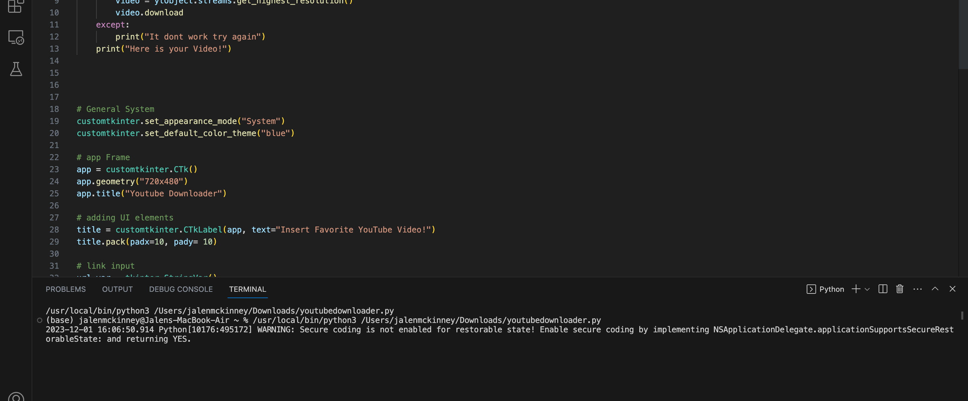
Save Offline! (YouTube Downloader)
Download any video you want with a simple copy and paste !
By Jalen McKinney

